Slide 1
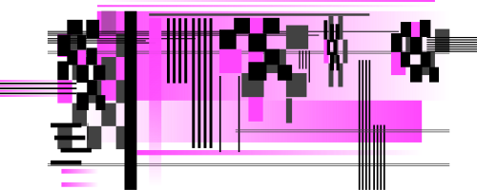
AI ALIGNMENT IN CRIMINAL JUSTICE
Ensuring fair juror selection in legal proceedings

Slide 2

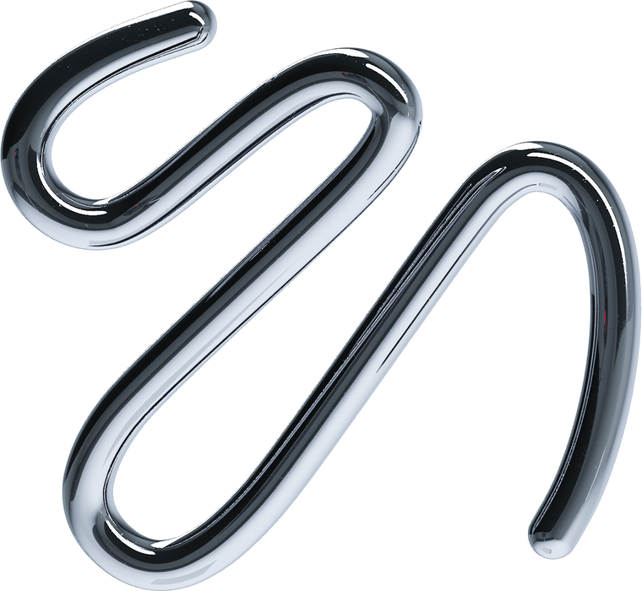
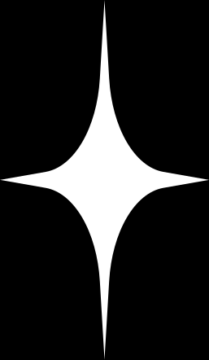
CURRENT LANDSCAPE OF JURY SELECTION
BACKGROUND
Fair jury trials are fundamental, yet deliberation process compromised by social dynamics.
Research found that one or two jurors influence outcomes (Devine et al., 2001).
PROBLEMS
During Selection:
Demographic Under-representation
Systemic Biases in Source Lists
Sampling Inequities
During Deliberation
Influence of Biases
Communication Barriers
Dynamic Power Imbalances

Slide 3


PROPOSAL
Develop a robust mathematical framework to model juror selection & interactions.
01
02
To integrate insights from game theory and optimization to:
Promote balanced participation.
Mitigate implicit biases.
Ensure fair demographic representation.
Enhance the quality of deliberations.
To assist researchers in analyzing such issues by modeling social behavior in mock trials.
03

Slide 4



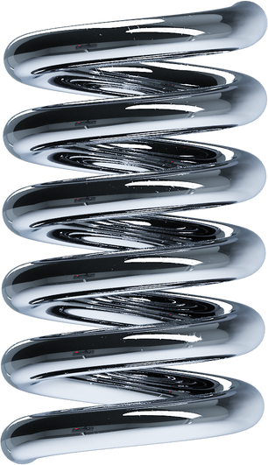
Mathematical Overview
optimization model
game-theoretic component
Ensures that the selected jury meets fairness and legal criteria while balancing societal goals (e.g., proportional representation, legal compliance, and minimizing bias).
Models strategic behaviors of jurors (e.g., participation incentives, biases, or preferences) to ensure robustness and fairness.

Slide 5

FAIRNESS-CONSTRAINED OPTIMIZATION

Slide 6

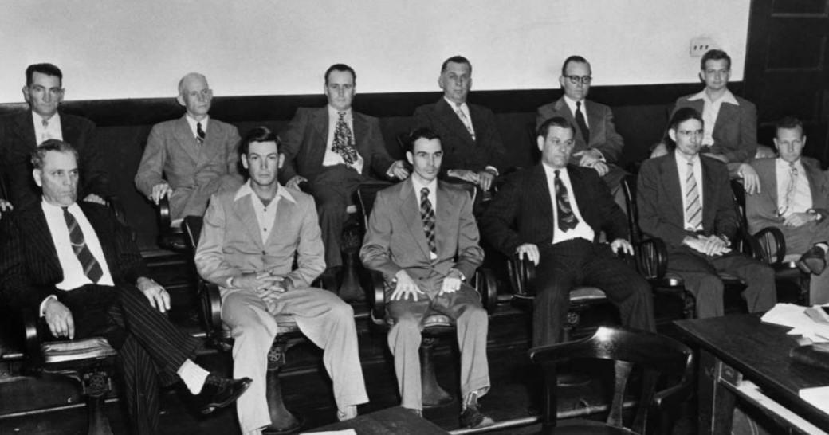
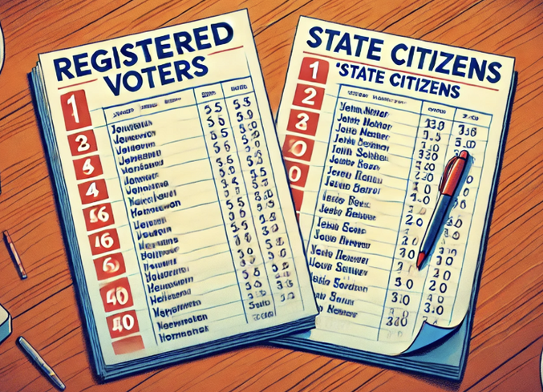
current challenges
Demographic Under-representation:
Summoning Disparities
In 1952, this all-white, all-male jury convicted Walter Lee Irvin, an
innocent Black man, of the kidnapping and rape of a Florida woman.
Mr. Irvin and three other innocent Black men who were falsely
accused of the crime became known as the “Groveland Four.”

Slide 7

Minimization Objective Function
Data collection: containing race, gender, age, income, language proficiency, disability status, geographic location.
Historical data on response rates by demographic groups to estimate nonresponse probabilities.
xi = 1 if individual i is selected, 0 otherwise

Slide 8
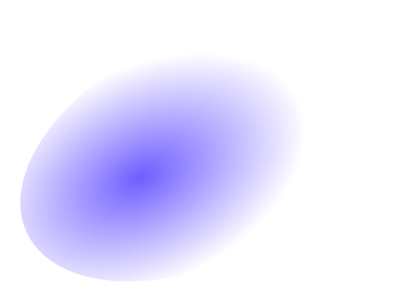
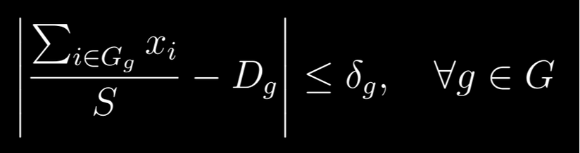

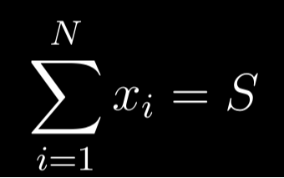
CONSTRAINTS
Weighted Demographic Representation:
N: Total number of eligible individuals.
S: Total number of jurors to select.
G: Set of demographic groups.
Ng: Number of eligible individuals in group g.
Dg: Desired proportion of group g in the jury pool.
δg: Acceptable deviation for group g.
wg: Sampling weight assigned to group g to compensate for lower summoning rates.
pg: Estimated nonresponse probability for group g.
Ng = Ng *wg: Weighted number of eligible individuals in group g
Total Juror Selection:
Guarantees exactly S
jurors are selected.

Slide 9
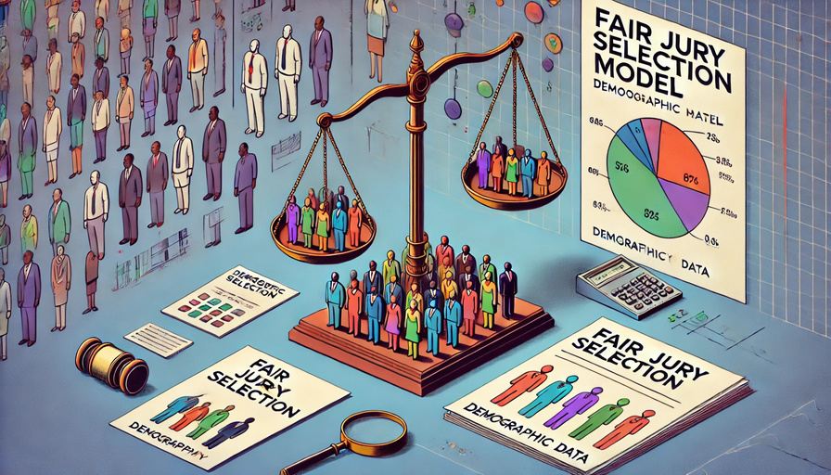
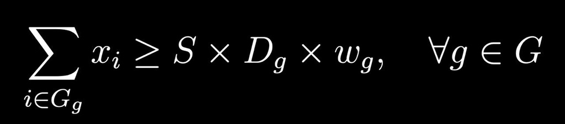
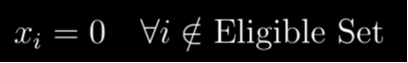
Sampling Weight Integration:
Eligibility Constraints:
Adjusts the minimum number of jurors selected from each group g based on the assigned sampling weight wg.
Ensures only eligible individuals are considered for selection

Slide 10

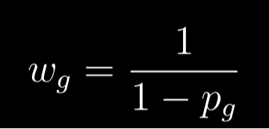
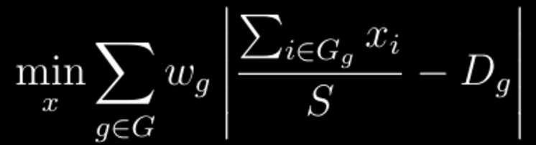
Weight Assignment
Objective Function
pg is the estimated nonresponse probability for group g. Higher pg results in higher wg, increasing the selection probability for group g.
This function minimizes the weighted sum of deviations from desired demographic pro portions, prioritizing underrepresented groups through higher weights wg.

Slide 11

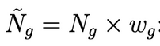
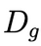
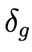
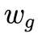
Algorithm
01
02
03
04
05
06
07
Initialize
juror Pool
Define Parameters
and Constraints
Adjust for
Sampling Weights
Formulate and
Solve
Random Selection
Within Groups
Adjust for
Non-response
Refine
Results
Compile list of candidates using source lists.
Demographic proportions:
Acceptable deviations:
Sampling weights:
Minimize objective function with constraints, xᵢ find selection
Randomize selection within demographics to reduce selection bias.
Over-sample groups with lower response
rates or adjust weights to account for non-response.
Iteratively refine the model with actual response data to maintain
demographic targets.
for each group g.

Slide 12
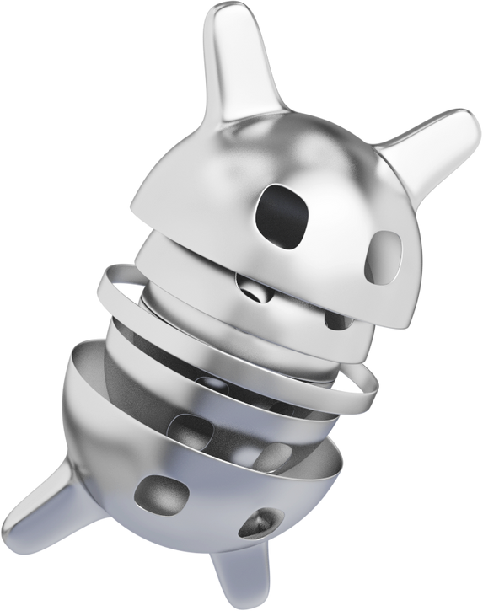
JUROR INTERACTION MODELING

Slide 13
introduction
objective
address
Promote balanced participation
Improve quality of deliberations
Contribute to a fair and well-informed trial
Problems of unbalanced deliberations
Influence of hidden biases.
challenges in Juror Deliberations
framework
Unbalanced Deliberations:
Dominant Personalities: Small number of jurors dominate discussions; 1 or 2 jurors do over 50% of the talking (Devine et al., 2001).
Reduced Participation: Less assertive jurors may not share their perspectives; limited consideration of evidence.
Influence of Biases:
Groupthink: Jurors may conform to the majority opinion to avoid conflict, even if they have doubts (Asch, 1956).
The framework models jury deliberations as a non-cooperative game, balancing individual beliefs, social influences, and effort costs.
It introduces a novel equilibrium concept to account for dynamic interactions.
We provide a mathematical tool for analyzing group decision-making.

Slide 14
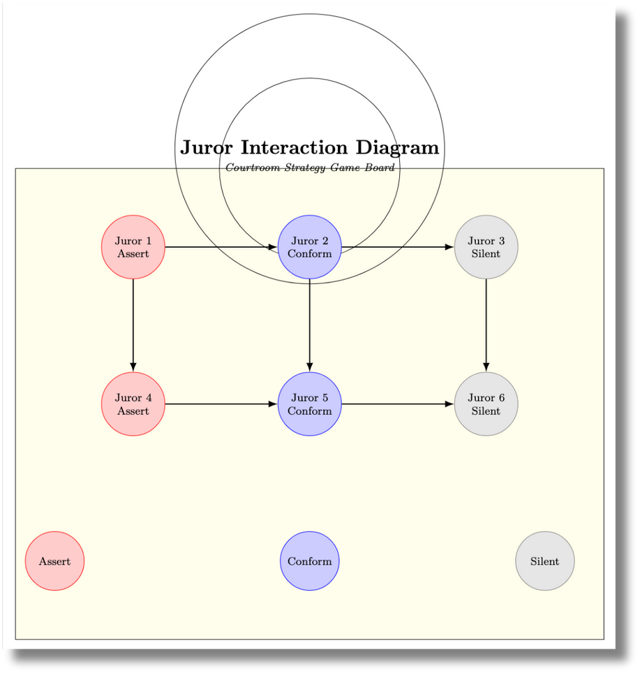
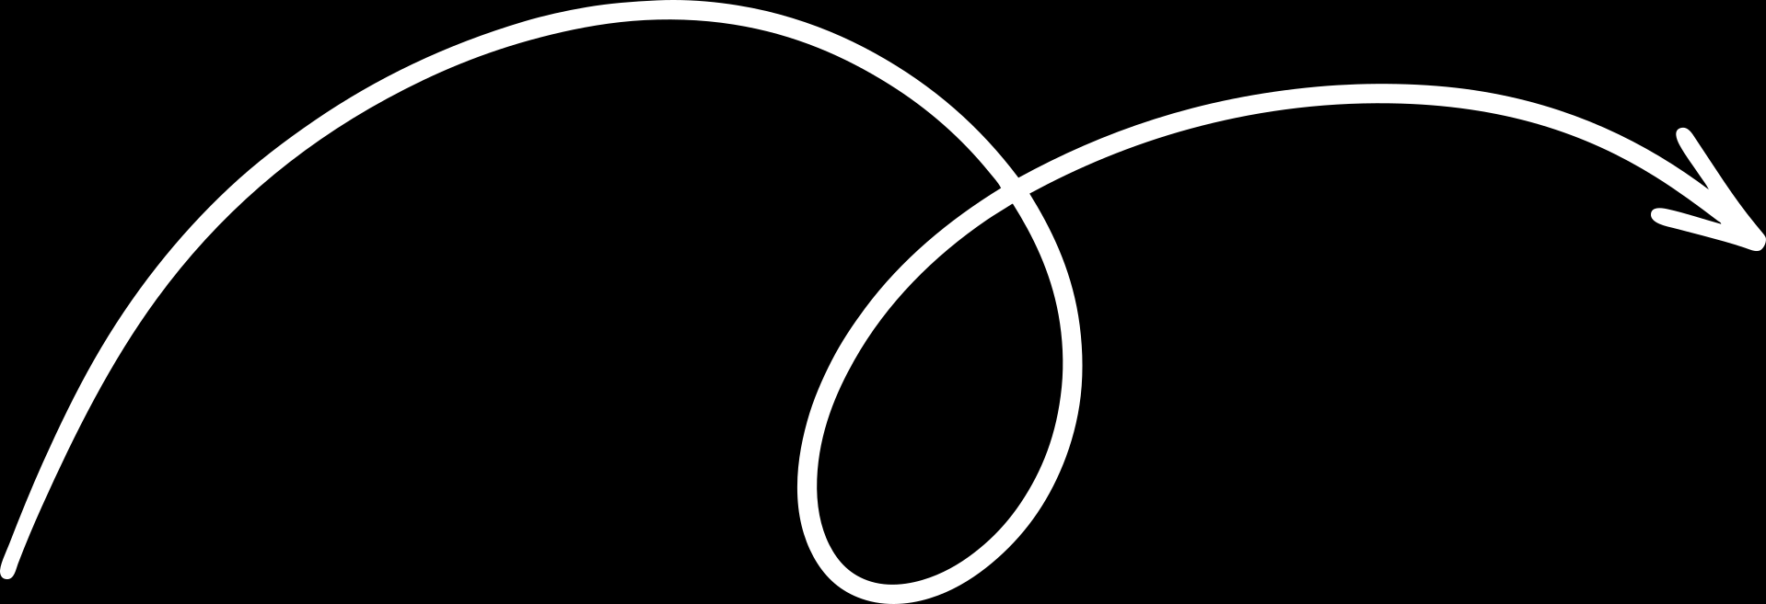
Mathematical Framework
Jurors are “players” in a game, with unique characteristics and decision-making strategies.
Interactions between jurors are analyzed as a non-cooperative game.
An attempt to capture social dynamics—like influence and dominance— mathematically.
Introducing the Concept of Strategies and Payoffs
Each juror, while part of a deliberative group, acts in their individual interest,
driven by their beliefs, biases, and goals.
Juror Strategies
Assert (A): Actively argue for their perspective.
Conform (C): Align with the majority opinion.
Silent (S): Refrain from participation.
Payoff Functions:
Measure the benefits from chosen strategy
Include factors such as belief strength, susceptibility to influence, and effort aversion.
Objective:
Understand how strategies and social interactions lead to collective decisions.
Predict and mitigate biases or unfair dynamics during deliberations.

Slide 15
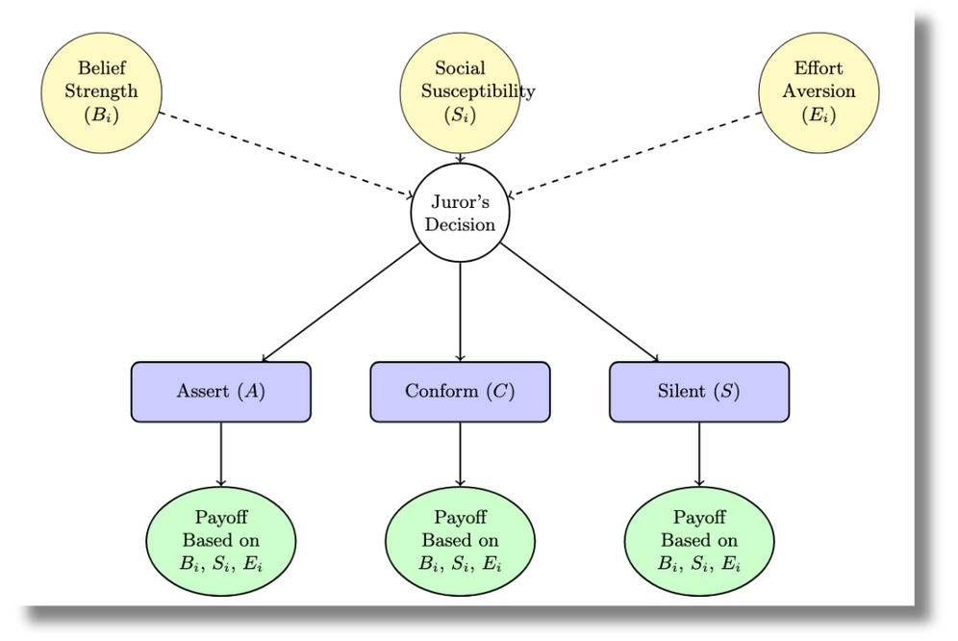
Foundations of the Juror Interaction Model
Key Metrics
Belief Strength (Bᵢ):
This represents how strongly juror i believes in a specific verdict (guilty or not guilty).
It’s a measure of conviction; higher values indicating greater confidence in judgment.
Social Susceptibility (Sᵢ):
This quantifies how easily juror i is influenced by the opinions of others.
Higher the value, higher the likelihood of conforming.
Effort Aversion (Eᵢ):
This indicates how much juror i dislikes actively engaging in discussions or arguments.
Higher values imply the juror prefers to avoid effort-intensive strategies like asserting their belief.
Impact of the metrics
Jurors’ decisions are influenced by their personal metrics (Bᵢ, Sᵢ, Eᵢ), which shape their payoff evaluations.
The model allows us to predict how these metrics drive individual choices and group dynamics.

Slide 16
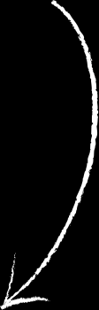
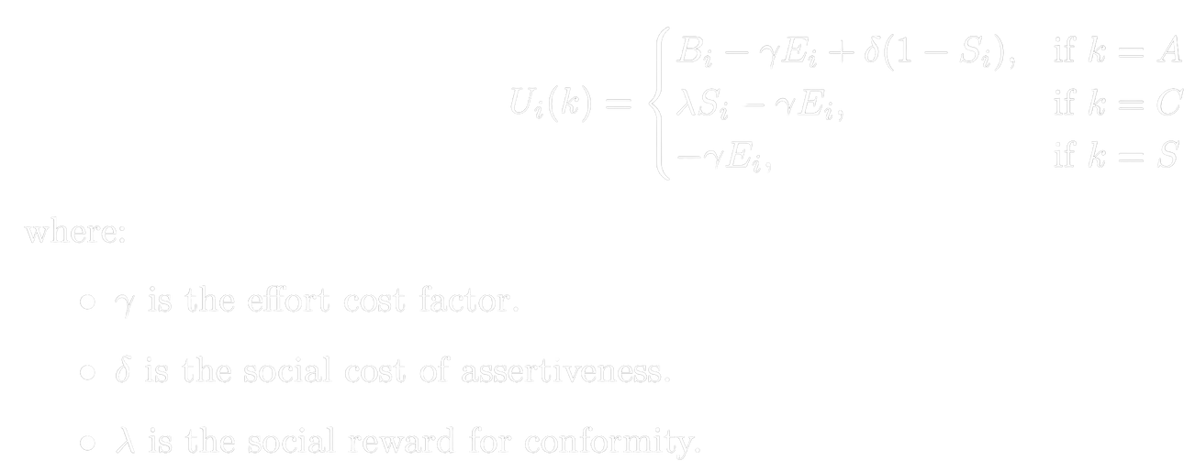
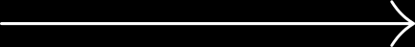
Payoff Function
The payoff function defines the reward juror i receives for choosing a strategy k∈{A,C,S}. It balances their belief strength (Bᵢ), susceptibility (Sᵢ), and effort aversion (Eᵢ):
Reward depends on belief strength (Bᵢ), penalized by the effort cost (Ɣ Eᵢ).
1 - Sᵢ implies that jurors less susceptible to social influence (Sᵢ) gain additional payoff for asserting.
Payoff depends on the social reward (λ) for being susceptible (Sᵢ).
Effort cost (Ɣ Eᵢ) is subtracted.
Only the effort cost is subtracted, as silence minimizes participation.
Equilibrium Analysis
Nash Equilibrium: A stable state where no juror can unilaterally switch strategies to improve their payoff.
Other game theory strategies that assume coordination or external influence don’t align with the independent, self-interested, and interdependent nature of the jurors’ decision-making.
Nash Equilibrium uniquely models the strategic interactions in a deliberative setting.

Slide 17
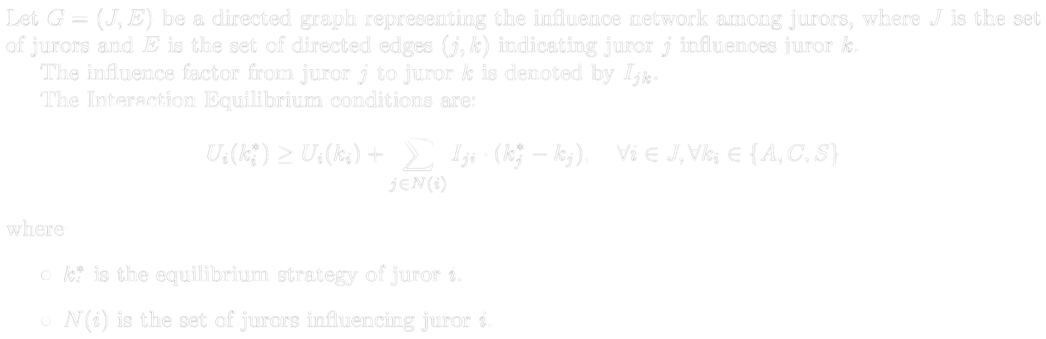
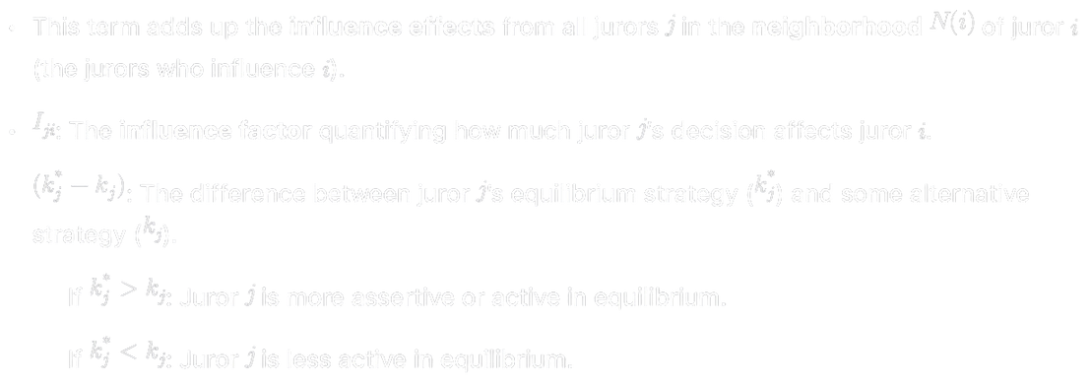
Interaction Equilibrium (IE)
This novel concept extends the Nash Equilibrium to account for influence networks, where jurors’ decisions are interdependent.
Definition: An Interaction Equilibrium (IE) is a state where no juror can unilaterally change their strategy to improve their payoff, given the influence of other jurors.
This accounts for the network of influence where each juror’s decision affects and is affected by others.
Key Features of Interaction Equilibrium:
IE accounts for dynamic updates in payoffs due to changing strategies of connected jurors. This better reflects the real-time, evolving nature of juror deliberations.
IE can capture social amplification, where the decision of a strongly influential juror propagates through the network, causing cascading shifts in strategies.
IE finds equilibrium not just as a static point but as a dynamic state that incorporates how jurors iteratively respond to their network influences, leading to a more realistic and nuanced understanding of group behavior.

Slide 18
Juror Interaction Modeling Algorithm
Initialization
Best Response Calculation
Strategy Update
Convergence Check
Assign an initial strategy to each juror, typically Conform.
For each juror, calculate the payoff for each possible strategy
considering the current strategies of influencing jurors.
Update the juror’s strategy to the one that maximizes their payoff.
Repeat the best response calculation and strategy update until no juror
changes their strategy.

Slide 19
How to implement in real life?
Measuring Belief Strength, Social Susceptibility, and Effort Aversion
Belief Strength: Responses are averaged to obtain Bᵢ for each juror.
Psychometric Scales: Standardized questionnaires to assess the intensity of jurors’ beliefs. Ex: Jurors rate statements like “I am confident in my verdict” on a 1 (Strongly Disagree) to 5 (Strongly Agree) Likert scale.
Behavioral Indicators: Measure behaviors like speaking frequency and argument persistence to assess strong convictions.
Confidence Ratings: Jurors rate their post-deliberation verdict confidence from 0% to 100%.
Social Susceptibility: Scores are aggregated to determine Sᵢ for each juror.
Social Influence Scales: Assess conformity using validated tools like the Social Influence Questionnaire, with statements like “I often change my opinion to match others’ opinions.”
Conformity Tasks: Compare jurors' decisions made in isolation versus in groups to assess influence of group dynamics.
Peer Assessment: Jurors rate peers' influence on their final decisions post-deliberation.
Effort Aversion: Average responses provide Eᵢ for each juror.
Self-Report Questionnaires: Measure jurors' attitudes toward effortful tasks using Likert-scale items like “I prefer tasks that require minimal effort.”
Behavioral Observations: Track jurors' participation by measuring speaking time and discussion-driving initiatives.
Task Performance Metrics: Observe task preferences by offering jurors roles of varying effort, like note-taker or facilitator.

Slide 20
How to implement IRL?
Determining γ, δ, and λ
γ (Effort Cost Factor): Average responses help quantify γ.
Researchers estimate γ by surveying jurors on their perceived effort costs: “On a scale from 1 to 10, how much effort do you associate with actively asserting your opinion?”
δ (Social Cost of Assertiveness): Responses are used to quantify δ.
Peer Feedback: Gather jurors' feedback on the social cost of assertive behaviors post-deliberation.
Self-Assessment Surveys: Jurors evaluate social costs of assertiveness with items like “I felt socially isolated when assertive.”
Behavioral Indicators: Count conflicts or negative reactions to measure social tension from assertive behavior.
λ (Social Reward for Conformity): Average scores determine λ.
Perceived Social Approval Surveys: Evaluate jurors' perceptions of social rewards with items like “I feel valued when I agree with the majority.”
Observation of Social Dynamics: Track positive feedback, like compliments, received by jurors who conform.
Behavioral Experiments: Test responses by offering incentives for jurors aligning with group decisions.

Slide 21

Mock Trial
HLSMTA (and others like it) involve jury simulations.
People v. Canning
Mr. Canning, who is accused of murdering Ms. Florrick in a theater restroom at Harvard.
Case materials include witness statements, evidence exhibits, and detailed fact patterns.
Before a simulated jury: conduct witness examinations, deliver closing and opening arguments, etc.
Others: Illinois State Bar Association Mock Trials, Maine Bar Association, New York State Bar Association, American Bar Association

Slide 22
How to implement IRL?
Calculating Influence Coefficients (I_{jk})
Example in research
I_{jk} quantifies the influence juror j has on juror k. Measurement methods:
Peer Nomination: Have jurors nominate peers who they believe influence their opinions.
Example: Each juror lists others who impact their verdict, and the number of nominations signifies influence strength.
Behavioral Observations: Observe interactions to identify influential jurors based on leadership behaviors or frequency of successful persuasion.
Example: Tracking which jurors’ suggestions are adopted more often by others.
Statistical Modeling: Use regression or other statistical techniques to model influence based on interaction data.
Example: Analyzing how changes in one juror’s strategy correlate with changes in another’s.
Social Network Analysis (SNA): Map and analyze the relationships and interactions among jurors to determine influence strengths.
Example Tools: Surveys where jurors indicate who influences their decisions, or analyzing communication patterns during deliberations.
Step 1: Data Collection
After deliberations, jurors complete a survey indicating to what extent each peer influenced their decision on a scale from 0 (no influence) to 1 (complete influence).
Step 2: Matrix Formation
Create an influence matrix I where each entry I_{jk} represents the influence juror j has on juror k.
Step 3: Normalization
Ensure that for each juror k, the sum of I_{jk} across all j does not exceed 1, representing the total influence on k.
Step 4: Verification
Validate the influence coefficients by cross-referencing with observed behaviors or additional qualitative data.

Slide 23
IRL
Research Objective: Investigate how individual juror characteristics and interpersonal influences affect the formation of verdicts in jury deliberations.
Study Design
Participants: Assemble a mock jury consisting of 12 or 6 participants.
Pre-Deliberation Assessments:
Administer questionnaires to assess Belief Strength, Social Susceptibility, and Effort Aversion for each juror.
Examples:
Belief Strength: “I am confident in my initial verdict opinion.”
Social Susceptibility: “I tend to follow others’ opinions in group settings.”
Effort Aversion: “I prefer to minimize my participation in discussions.”
Deliberation Sessions:
Conduct structured deliberations where jurors discuss a hypothetical case.
Data Collection:
Record interactions to observe participation levels and influence patterns.
Use video recordings for behavioral analysis.
Post-Deliberation Surveys:
Gather jurors’ perceptions of effort costs, social costs of assertiveness, and social rewards for conformity.
Example Items:
Effort Cost (\gamma): “Actively arguing my viewpoint required a lot of effort.”
Social Cost (\delta): “Being assertive made me feel socially isolated.”
Social Reward (\lambda): “Conforming to the group’s decision made me feel accepted.”
Influence Network Mapping:
After deliberations, jurors complete a survey indicating how much each peer influenced their final decision.
Example: Juror 1 rates Juror 2’s influence as 0.6, Juror 3’s influence as 0.5, etc., forming the influence matrix.

Slide 24
What’s the Point anyway?
Understanding Group Dynamics
Why it matters: In group decision-making, individuals often have varying levels of confidence, susceptibility to influence, and effort willingness. These factors shape outcomes in unpredictable ways.
How this helps: The framework models how individual preferences and behaviors interact to form collective decisions. By analyzing these interactions, researchers can identify:
What leads to consensus or deadlock.
The role of dominant individuals in shaping group outcomes.
How biases (like groupthink or assertiveness penalties) influence decisions.
Diagnosing and Mitigating Biases
Why it matters: Group decisions can suffer from systemic biases, such as groupthink (where members prioritize harmony over critical evaluation) or social loafing (where individuals contribute less effort in group settings).
How this helps: By quantifying parameters like social susceptibility (S_i) and effort aversion (E_i), researchers can:
Identify jurors more prone to conformity or disengagement.
Suggest interventions, such as reshaping deliberation protocols to encourage more balanced participation.

Slide 25
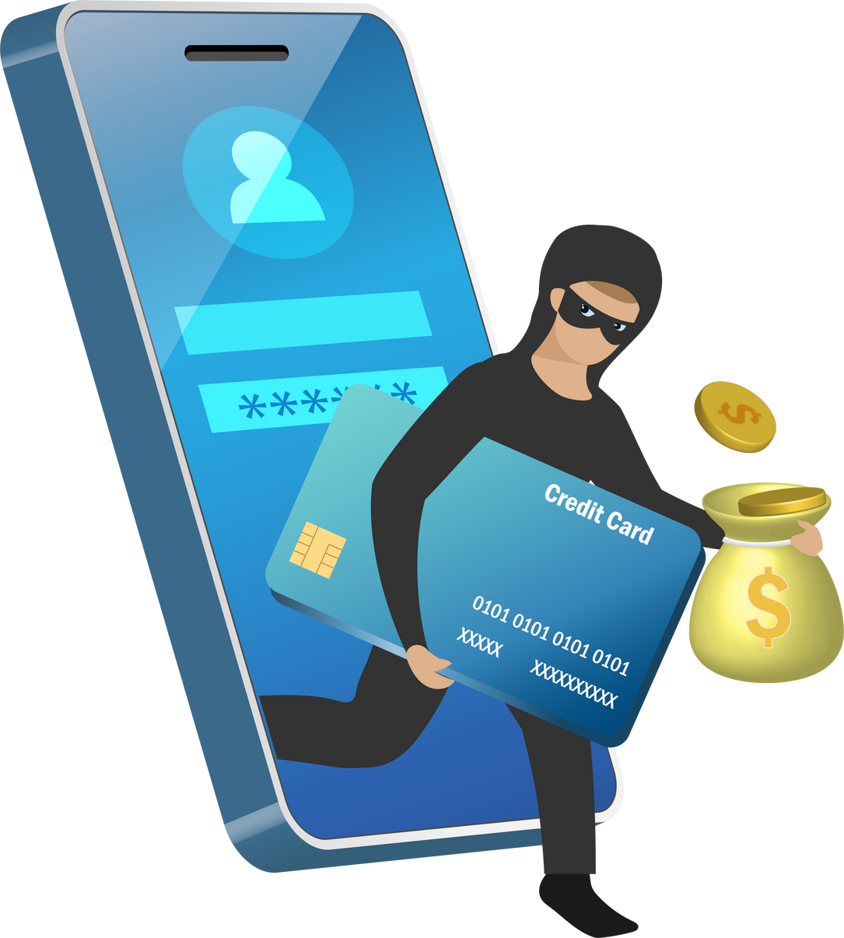
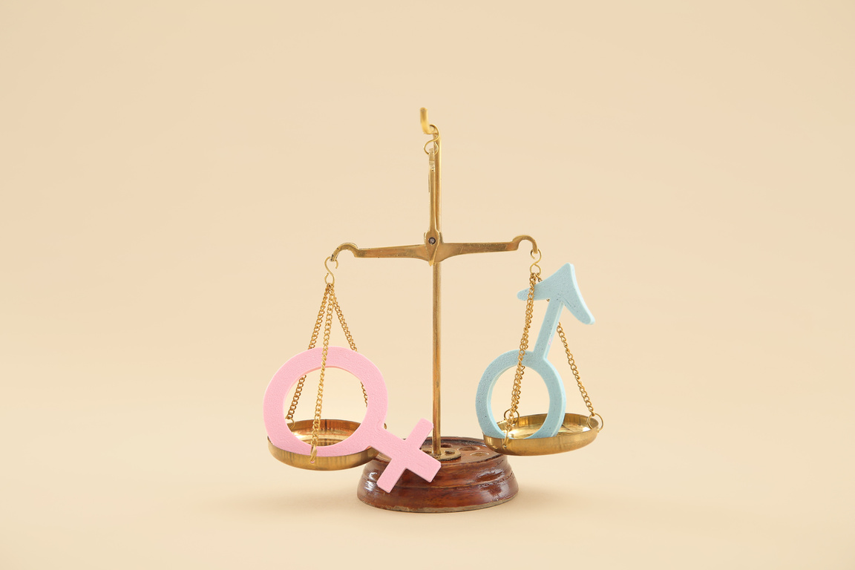
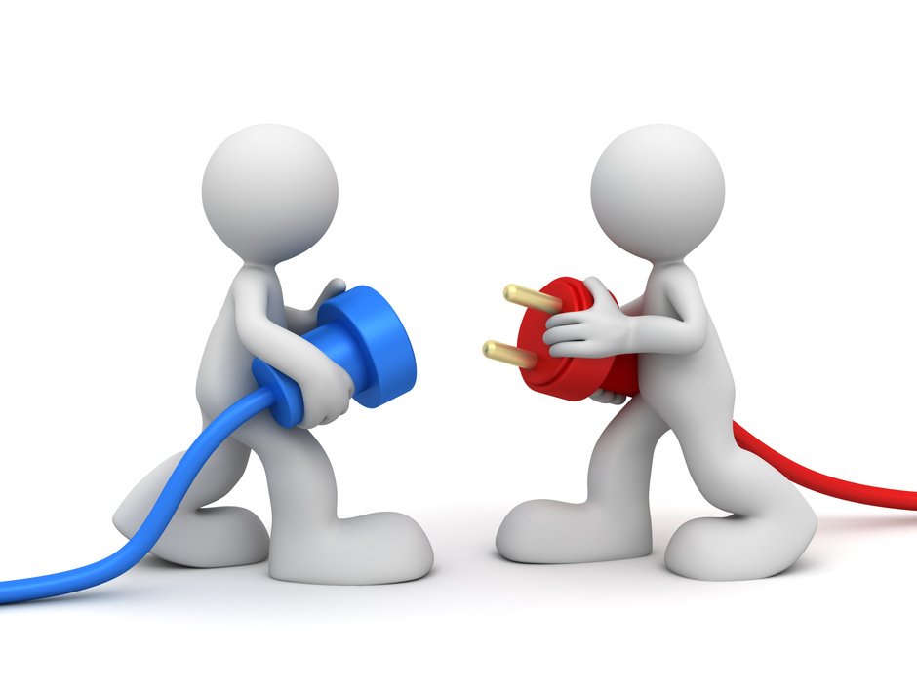
ETHICAL CONSIDERATIONS
Data Privacy & Security
Algorithmic Bias
Human Connection

Slide 26

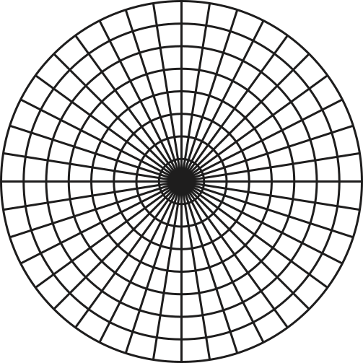

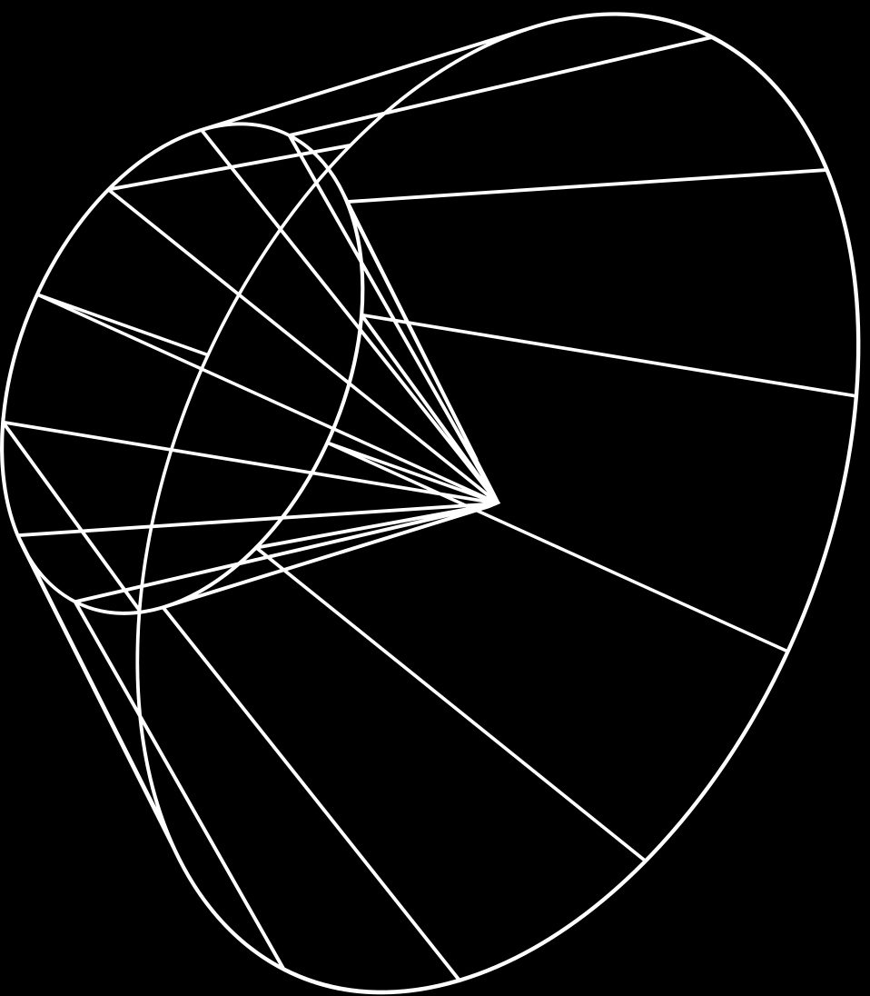
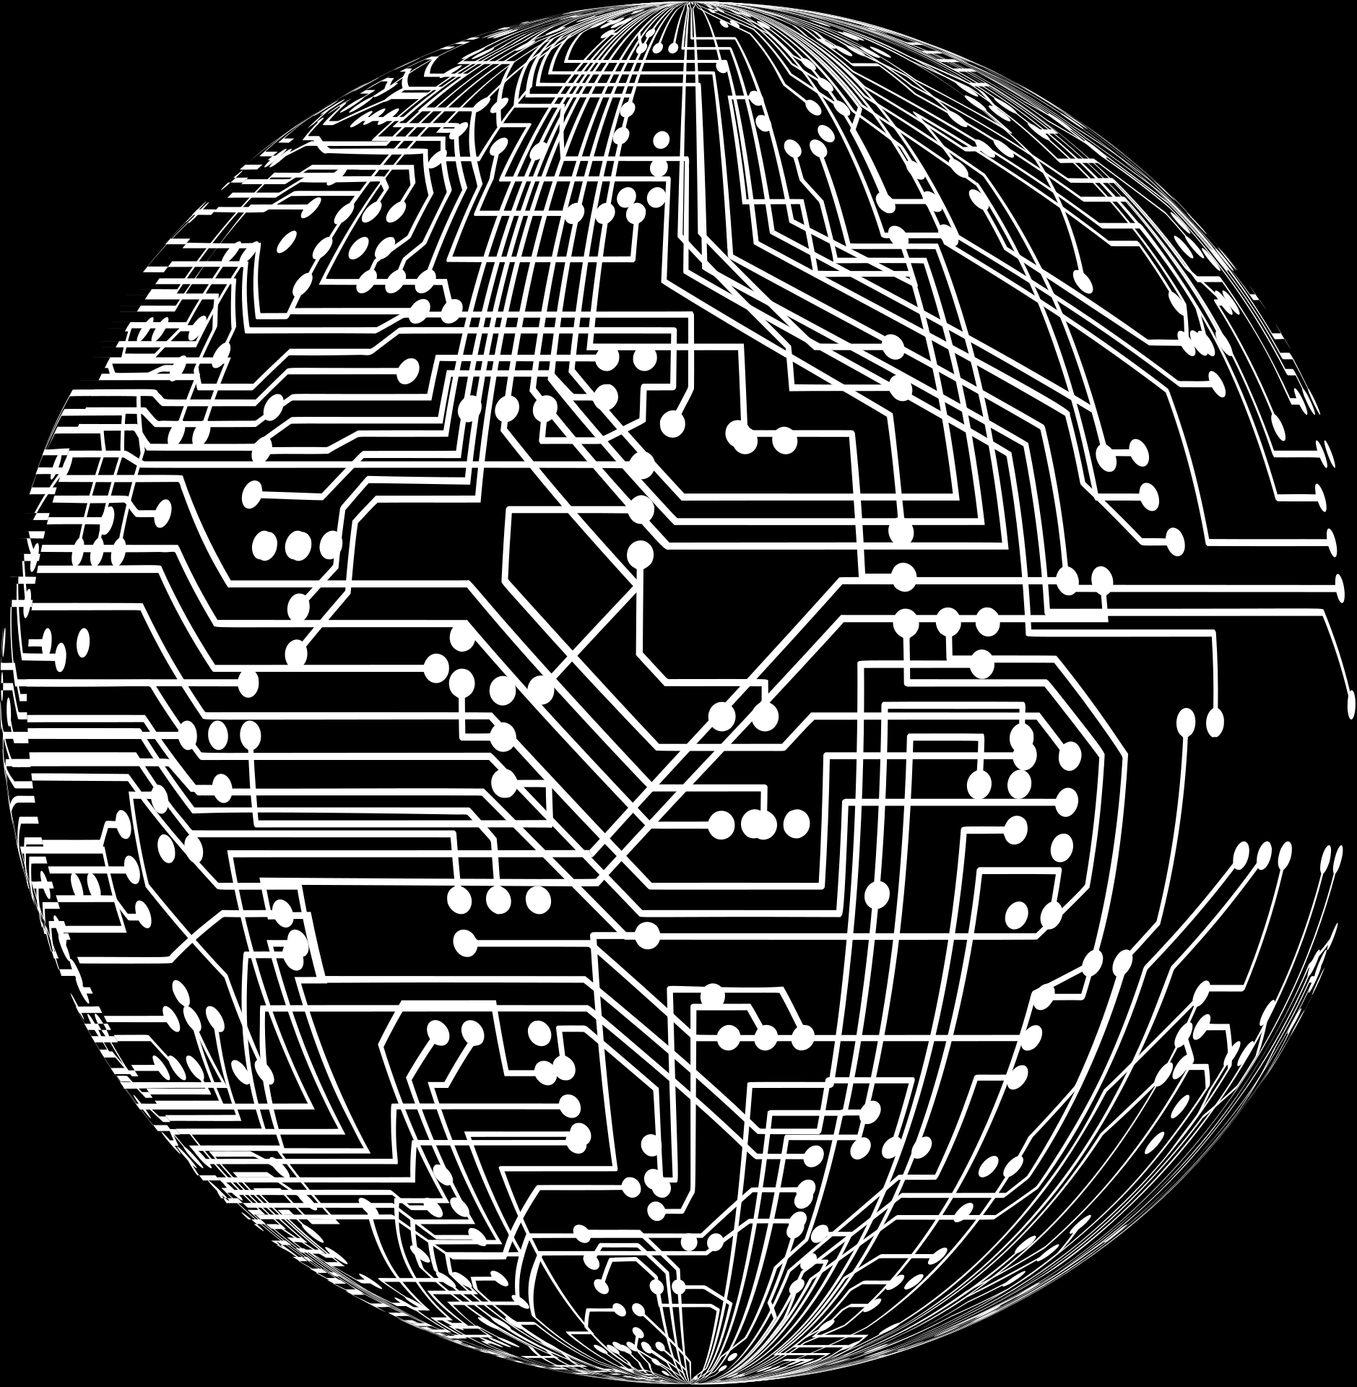


CONCLUSION
GROUP 7
Compensation for low summon rates
By integrating sampling weights into the s. This approach
Diversity
Ensures that the selected jury pool genuinely represents the community’s diversity, upholding fairness and legal standards.
Dominance & conformity bias
Designed to promote fairer deliberations and mitigate biases arising from dominance and conformity.
Research tool
Serves as a valuable resource for studying social dynamics within jury settings, contributing to the enhancement of judicial fairness.

Slide 27

LEONA
SHRID
MANDIRA
Q&A
THANK YOU!

